Slide 1

Ensuring the sustainability of the
State Land Cadastre and land relations infrastructure during martial law
Mr. Ihor Kyryliuk,
Deputy Director of the Department - Head of the Division of cooperation with other cadastres and information systems, Department of State Land Cadastre
StateGeoCadastre
November 2023

Slide 2







Authority of the StateGeoCadastre and limitations under martial law
Resolution of the Cabinet of Ministers of Ukraine No. 263 "Some issues of ensuring the functioning of information and communication systems, electronic communication systems, public electronic registers under martial law” dated
March 12, 2022.
Resolution of the Cabinet of Ministers of Ukraine No. 564 “Some issues of maintenance and functioning of the State Land Cadastre under martial law” dated May 7, 2022.
Key powers
Topography, geodesy, cartography
State land cadastre
Spatial Data Infrastructure
Public Cadastre Map closed for the open access
Land use and protection
State Geodetic Network Geoportal closed for the open access
Land use control
NSDI Pilot Geoportal closed for open access
Administrative services

Slide 3

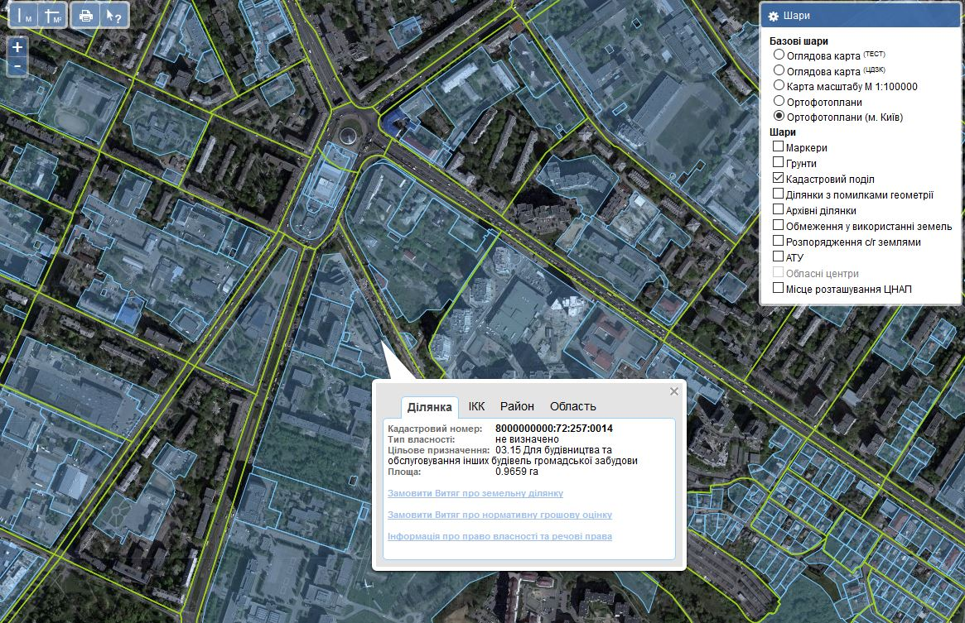
What is there in State Land Cadastre of Ukraine?
State Land Cadastre system contains such data:
Administrative boundaries
Land use limitations
Index cadastral maps
Melioration systems and complexes
Orthophoto
Information about the land within the administrative-territorial units:
Land parcels
Boundaries of administrative-territorial units
boundaries of territorial communities
agricultural soil groups
information about the lands
functional areas
masses of agricultural lands
Information on land and soil protection measures
Information on land contaminated by explosive ordnance

Slide 4
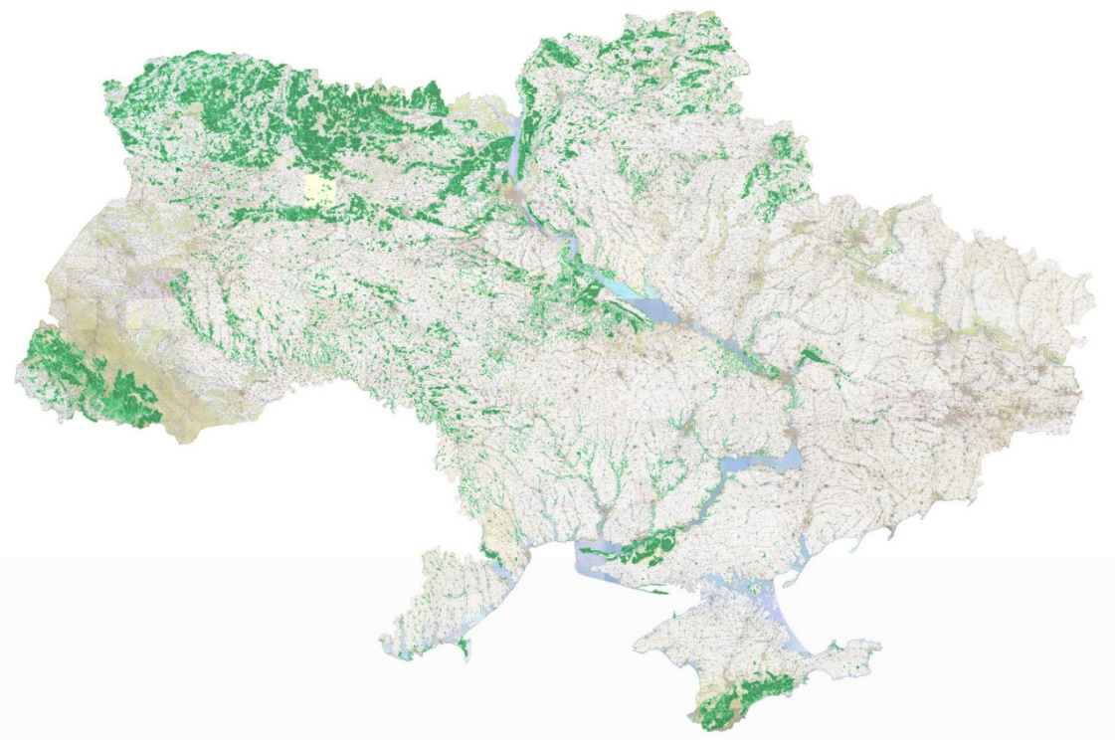
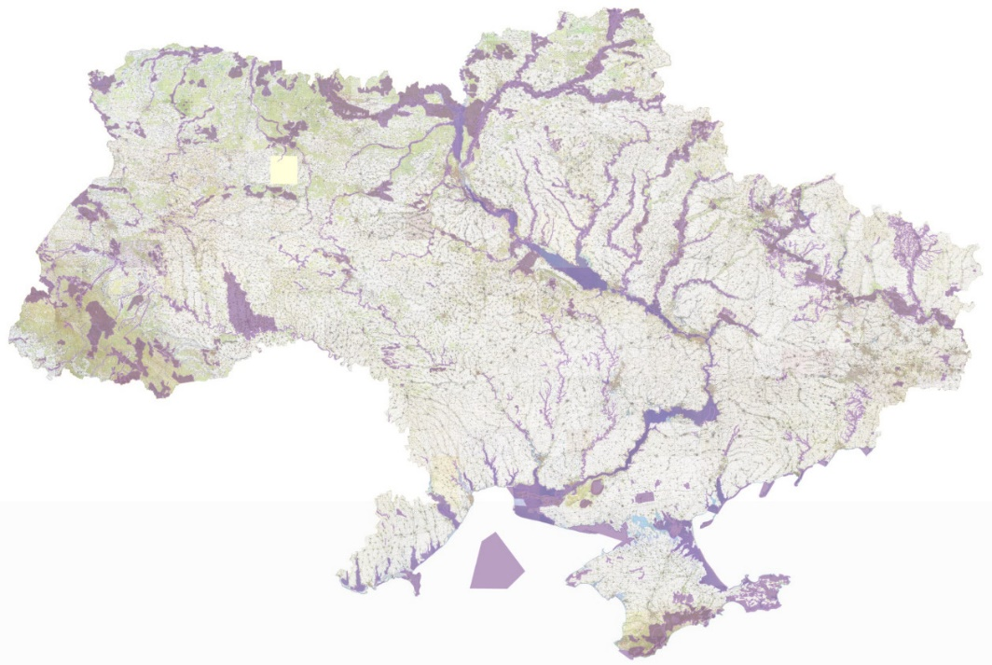
State Land Cadastre of Ukraine
The state land cadastre system contains information-reference layers:
Nature reserve fund
Emerald network
Wetlands of international importance
Forests
Hydrography
Defense lands
Information about energy facilities
Information on subsoil plots and issued special permits for subsoil use
Information on oil and gas wells

Slide 5
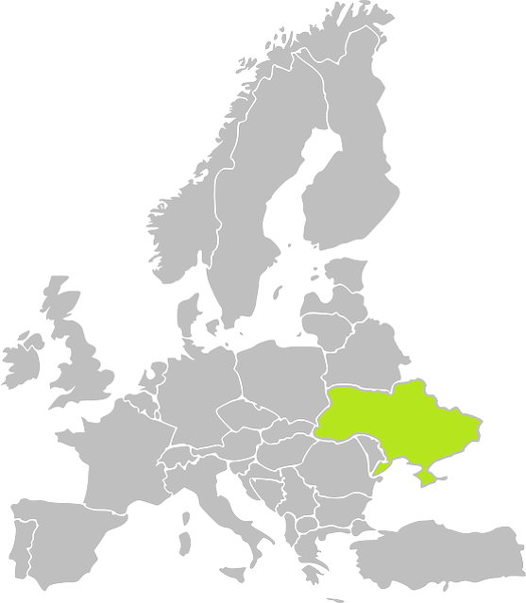
Development of the State Land Cadastre
Content of the
State Land Cadastre
Land parcels: 24,8 million parcels with an area of 44.6 million ha (472 447 parcels, 1 million ha in 2023)
Information on the state border - 776.2 km (Republic of Poland, Romania, Slovak Republic, Hungary)
Information on the boundaries of settlements – 10 687 administrative units (439 in 2023)
Information about melioration systems and complexes – 7 units (2023)
Information on the normative monetary valuation of settlements
11 510 settlements (191 in 2023)
Information about functional areas – 3 units (2023)
Information on land use limitations
1 322 (143 in 2023)
Information on the boundaries of territorial communities - 6 communities (2023)

Slide 6



Positive dynamics in the use of State Land Cadastre data
SIMPLE AUTHORIZATION
ACCESS TO THE STATE LAND CADASTRE FOR KEY STAKEHOLDERS
STATE AUTHORITIES
LOCAL COMMUNITIES
BANKS
ADMINISTRATIVE SERVICE CENTERS
NOTARIES
LAND SURVEYORS, GEODESISTS
EVALUATORS FOR EXPERT MONETARY VALUATION OF LAND PLOTS
PRIVATE EXECUTORS, INSOLVENCY OFFICERS
Digital signature
BankID
MobileID
1160
586
113
4727
2951
50
state authorities
local communities
administrative service centers
notaries
land surveyors, geodesists
private executors, insolvency officers

Slide 7
Key steps of the state during martial law
Suspension of the State Land Cadastre and the Public cadastral map
The Procedure for Determining Damage and Losses was approved
The procedure for acquiring rights to agricultural land has been simplified
Procedure for maintaining the State Land Cadastre under martial law approved
Restoration the operation of the
State Land Cadastre
Martial law has been introduced in Ukraine
24.02.2022
20.03.2022
07.04.2022
07.05.2022
17.05.2022

Slide 8
Key steps of the state during martial law
Special rules have been established for the location
of production facilities of enterprises that are relocated (evacuated) from the combat zone
Відновлено
The procedure for holding land auctions has been restored
Interagency working group on humanitarian demining established
The procedure for allocating land parcels for the construction and maintenance of engineering and fortification structures has been simplified
Tax benefits for damaged land have been determined
09.06.2022
19.11.2022
24.02.2023
23.03.2023
06.05.2023

Slide 9

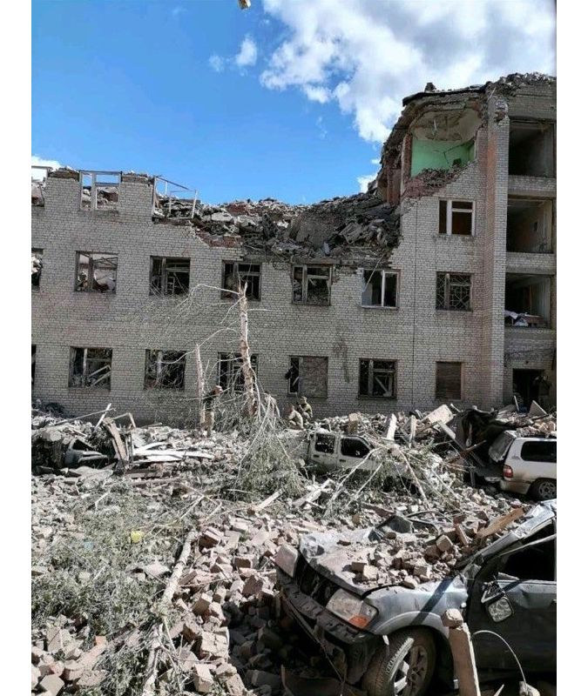
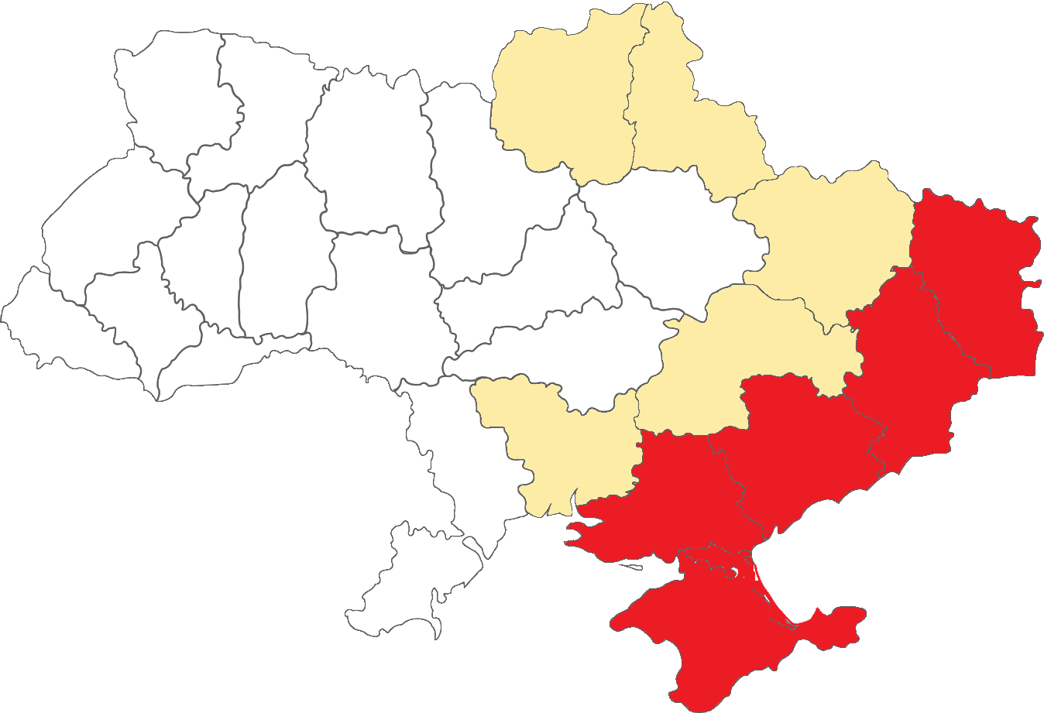
Operation of the State Land Cadastre under the martial time
The List of Territorial Communities Located in the Area of Military (Combat) Operations or Temporarily Occupied, Surrounded (Blocked) is being approved by the Ministry of Reintegration of the Temporarily Occupied territories (monthly update)
Order of the StateGeoCadastre dated 24.02.2022 No. 7-a "On suspension of the automated system of the State Land Cadastre and the Public cadastral map for:
Avoidance of manipulations with the SLC data
Employees' life and health preservation
Personal data protection
Order of the StateGeoCadastre "On approving of the administrative districts with terminated access to the State Land Cadastre
Territorial communities located in the military (combat) operations area or under temporary occupation, encirclement (blockade
Oblasts where territorial communities are either partially located in the military (combat) area operations or have been affected (destroyed/damaged) as a result of military (combat) operations

Slide 10

Major changes in Cadastre operation during martial time
IT WAS (PEACE TIME) It has become (WAR)
Exercise of authority by state cadastral registrars
Powers are exercised by all registrars throughout Ukraine
The SGC approves the list of registrars to operate in the territories of certain administrative territorial units
Publication of SLC information on the Public Cadastral Map
All SLC information is public, the PCM is operating, all layers and information are published
The SLC information is not published, the PCM does
not function
Access to SLC information on the coordinates of the turning points of the boundaries of SLC objects
The information is contained in all forms of documents provided in the form of administrative services
Use of information is allowed only to certain registrars, land managers, surveyors; information is not provided in extracts, copies of SLC documents
262 433
Procedure for disconnection (termination of access) to SLC registrars, other users
1 006 868
Access to the SLC is terminated in case of appeal against decisions, actions, inaction, due to violation of the law;
there is a possibility to restore access
Access of registrars is terminated for violation of certain restrictions
on decision-making. Access of other users is terminated for violation
of the law without the possibility of recovery. On the territory of the temporarily occupied administrative territorial units, access to the
SLC of all users is suspended

Slide 11
State Land Cadastre in 2022-2023
Functional for automated normative land valuation extracts for agricultural lands (outside the settlements) developed
Functional for automated normative land valuation extracts for lands (inside the settlements) developed
May 2022
July 2022
August 2022
October 2022
Restoration the operation of the automated system of the State Land Cadastre
Implementation of the functional for blocking of the access for selected territorial communities
January 2023
June 2023
August 2023
September 2023
Functional for providing an extract about land within the territories of territorial communities
Start of a pilot project to provide land managers
powers of state cadastral registrars
Functional for introduction of reclamation networks and functional zones to State Land Cadastre
Start of work on system reengineering

Slide 12
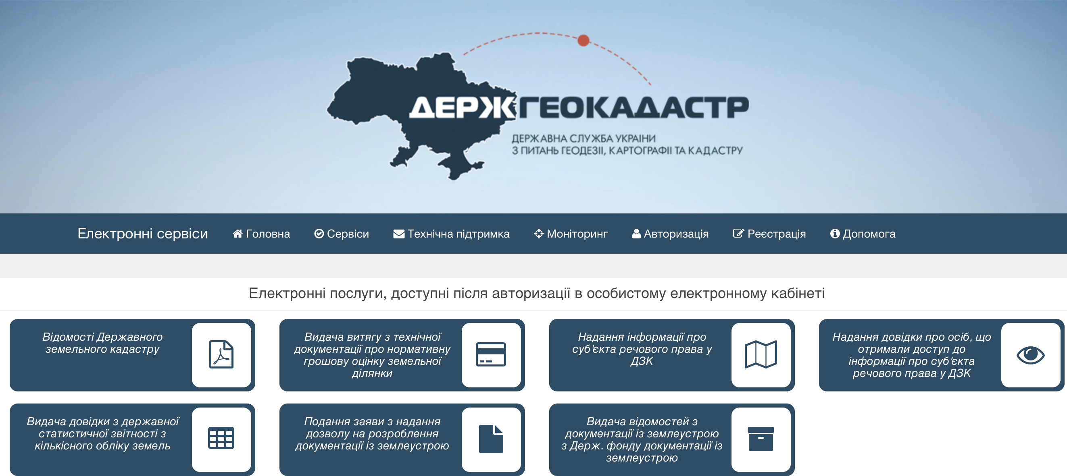
Functioning of the portal of E-services
Exterritorial approach – is the key principle of the E-services operation
The business process of the exterritorial service:
www.e.land.gov.ua
Supply of the documents or request for the service
Center of Administrative Services
Automated system randomly choose any of the cadastral registers to fulfill the service
Typically it takes 5 days for the completion of the service
OR
e.land.gov.ua
Ready service (extract, registration, etc) is sent to the Centre of Admin Services or to email
Portal of E-Services

Slide 13
Dynamics of land parcels’ registrations
1.2 mln.
1.1 mln.
1.2 mln.
877.7
936.4
726.3
518.6
Obtaining the land into ownership is prohibited
during the martial period

Slide 14
Dynamics of extracts from State Land Cadastre
Extracts from State Land Cadastre
Share of on-line extracts
25 %
41 %
75 %
2021
2022
2023
546 438
414 083
Online extracts

Slide 15




Priorities under the Martial Period
Proper security of the national registries and data bases, mainly State Land Cadastre, NSDI and Geodetic Network
Hardware to ensure the security of the systems and registries
Cloud-based storage for the strategic systems’ operation
Stable energy supply for the systems’ operation

Slide 16

Thank you for your attention!

